Slide 1
Notes:
The name Aptos comes from the Greek words - Anti Ptosis.

Slide 2
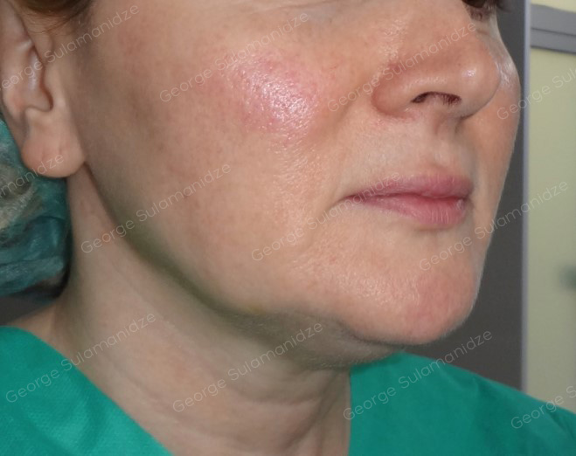
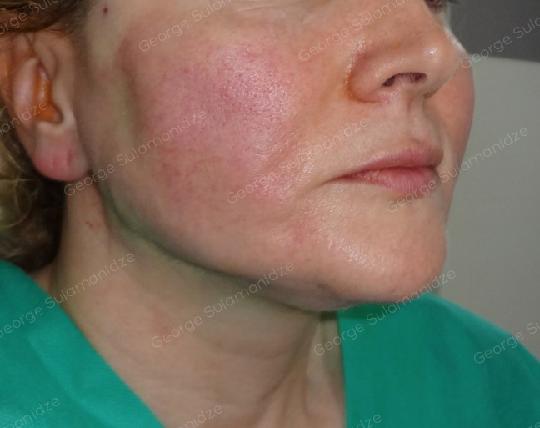
Results of the procedures
Before
After

Slide 3
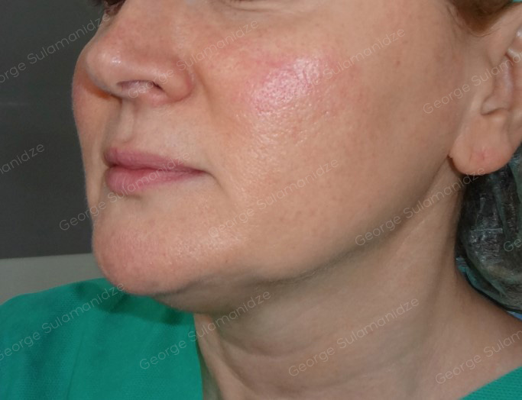
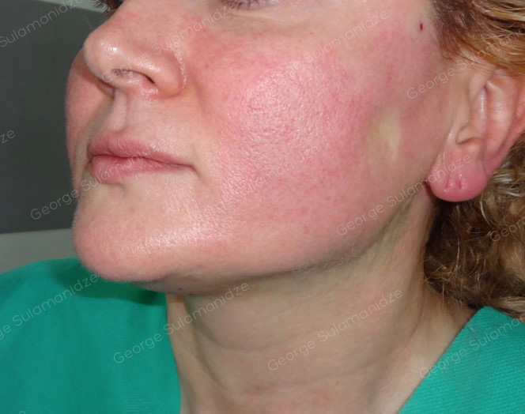
Results of the procedures
Before
After

Slide 4
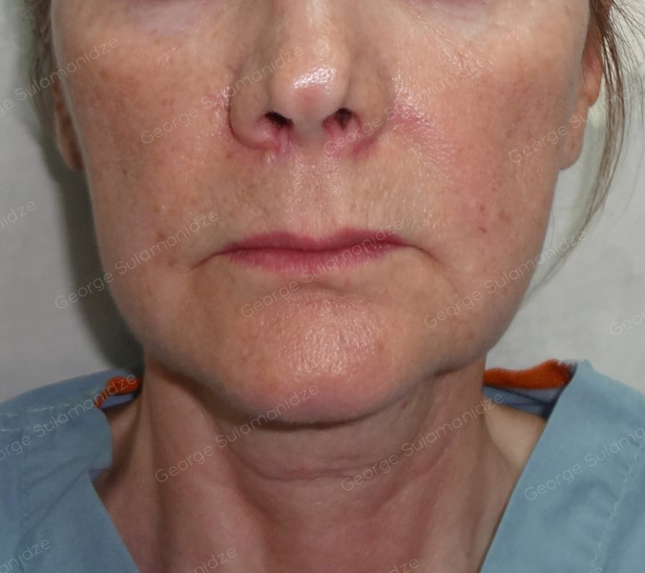
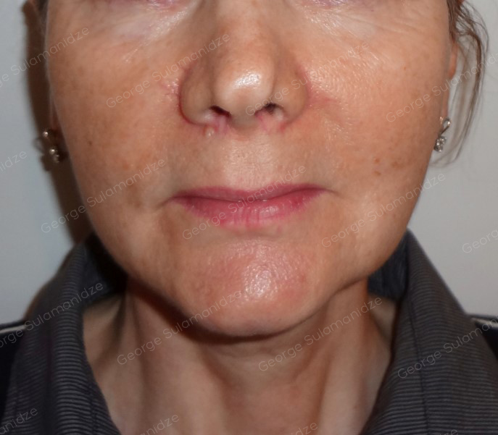
Results of the procedures
Before
After 6 months

Slide 5
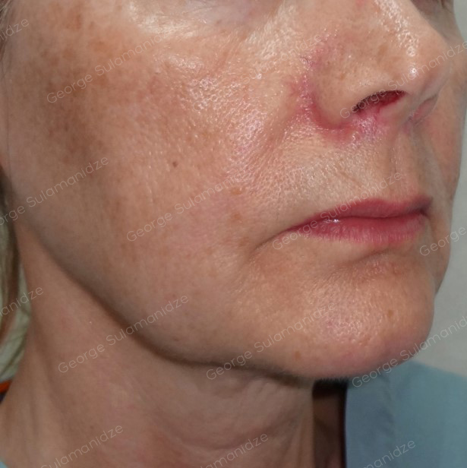
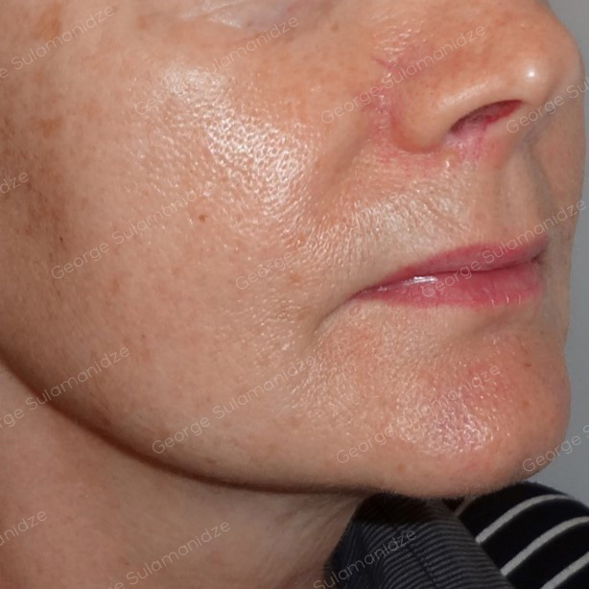
Results of the procedures
Before
After 6 months

Slide 6
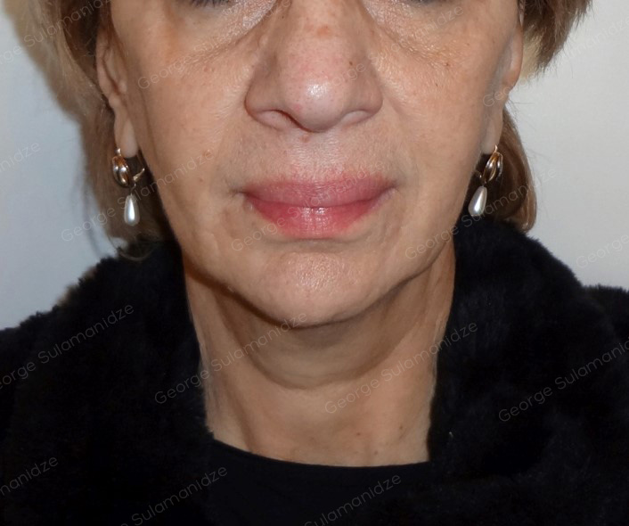
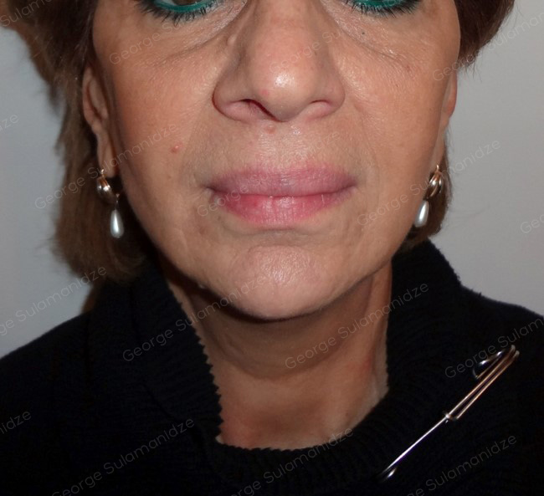
Results of the procedures
Before
After

Slide 7
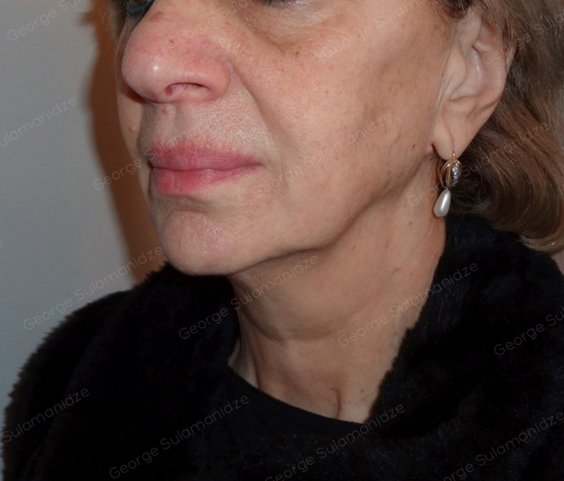
Results of the procedures
Before
After

Slide 8
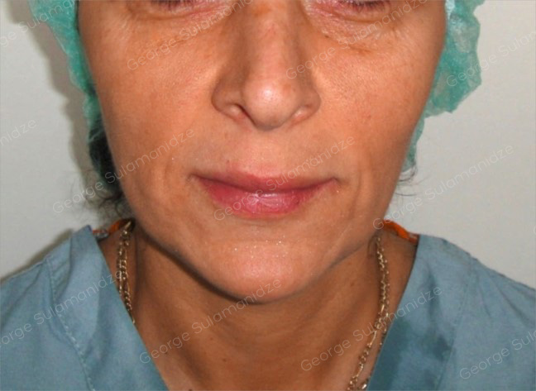
Results of the procedures
Before
After

Slide 9
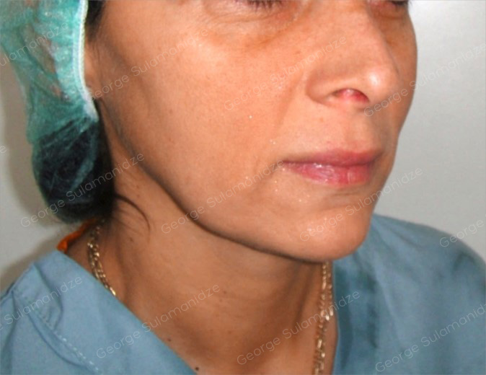
Results of the procedures
Before
After

Slide 10
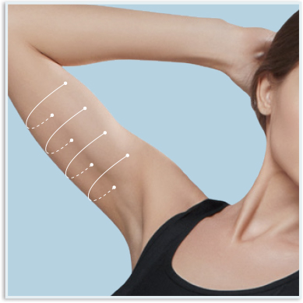
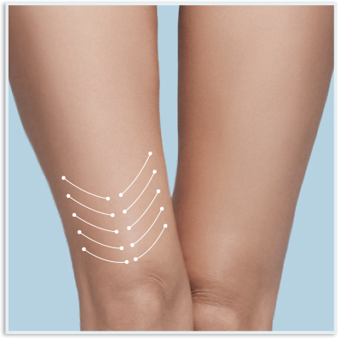
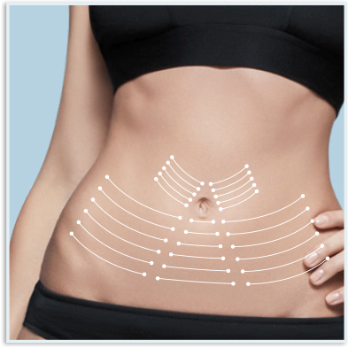
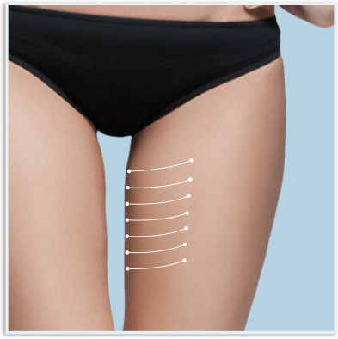
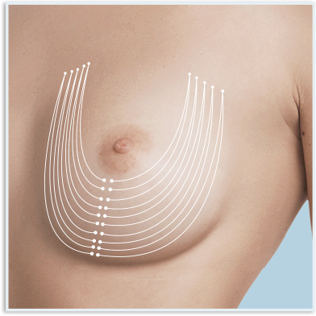
Body Excellence method – Technique description:
Marking
Notes:
Marking
Mark the operation area using medical marker. Marking ought to be made in an upright position symmetrically on the both sides of the face.
Arms: Mark entry points at the lateral side of the arm. Draw horizontal, parallel 5-10 lines till the other side of the arm.
Breast: .
Abdomen: Mark entry points around the nipple and draw lines parallel to the skin depression. You might need 20-30 threads for abdomen.
Inner Thighs: Mark entry points on the frontal medial part of thighs and draw parallel lines medially.
Knees: Mark entry points above the knee starting from the lateral and medial parts of the knee. Draw parallel lines medially form both sides. The lines should follow the direction of skin depression.

Slide 11
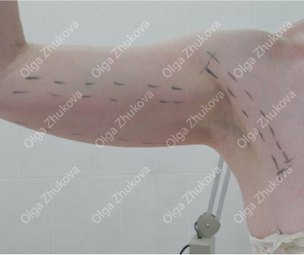
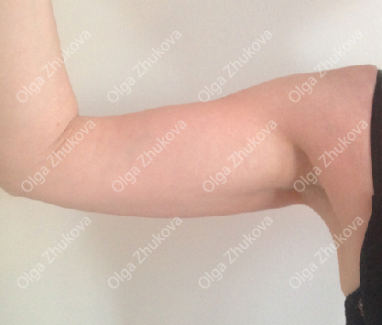
Results of the procedures
Before
After 6 months
After 2 years
11
Notes:
To improve soft tissues of inner side of arms it is better to apply the threads vertically. As neocollagenesis becomes active, the skin and subcutaneous tissue becomes tighter. Furthermore, effect is much better 2 years after the procedure rather than 6 months later.
You can see the photos of 50 years old patient (perimenopause) on the left, 6 months and 2 years after the procedure (menopause). You can see significant improvement of the skin tone and elasticity.

Slide 12
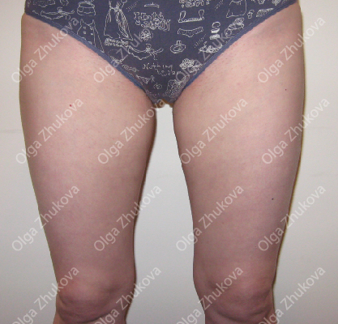
Results of the procedures
Before
After 6 months
After 2 years
12
Notes:
The same patient after correction of the inner thighs. And still the effect is much better after 2 years.
On the left the patient is 50 years old and on the right, she is 52 years old. There was no change in eating habits and lifestyle.
If you observe carefully, you can see significant improvement of the skin above the knee, even though there are no threads and it is the effect of tissue contraction at the thighs.

Slide 13
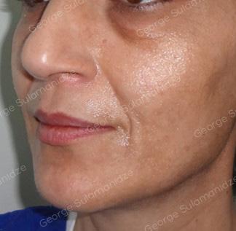
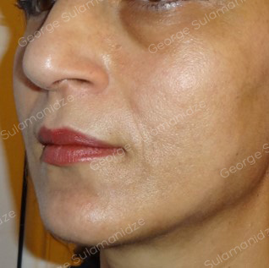
Results of the procedures
Before
After

Slide 14
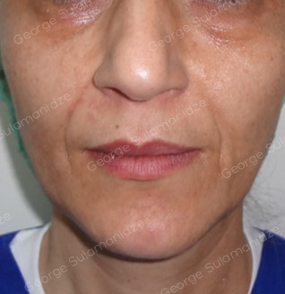
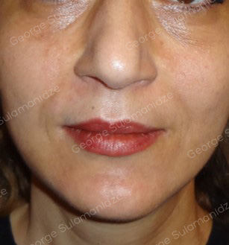
Results of the procedures
Before
After

Slide 15
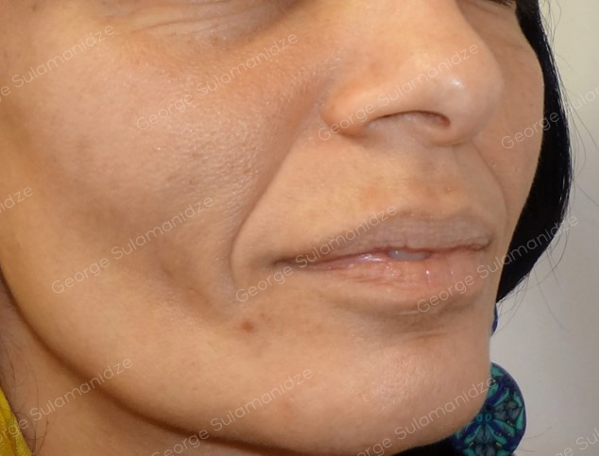
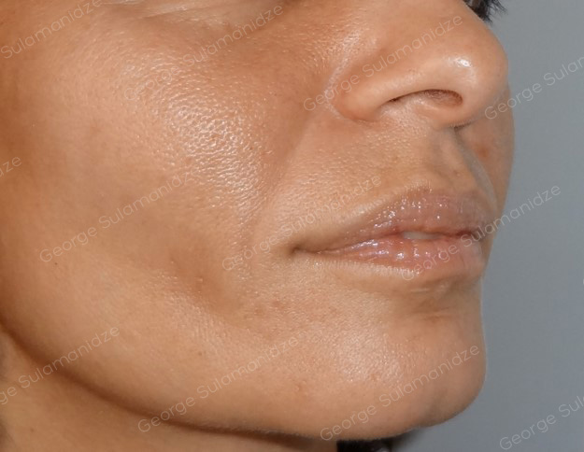
Results of the procedures
Before
After 6 months

Slide 16
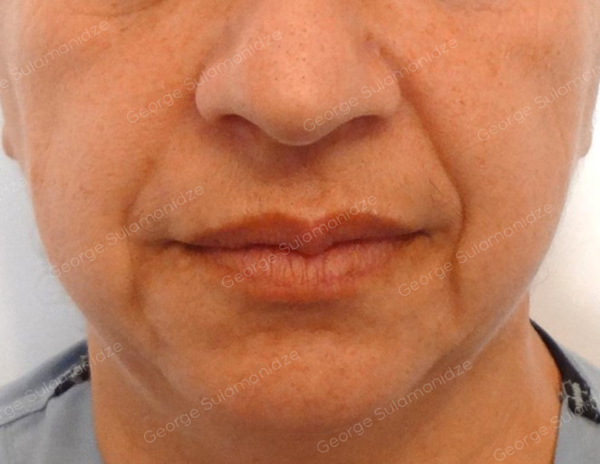
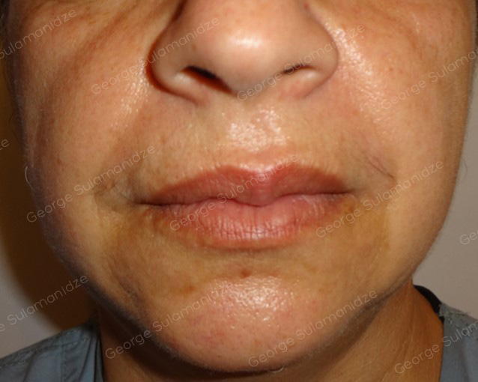
Results of the procedures
Before
After

Slide 17
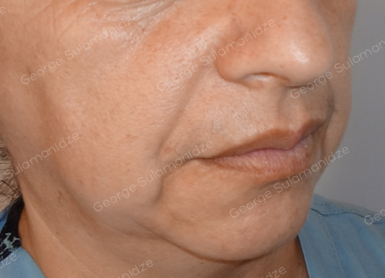
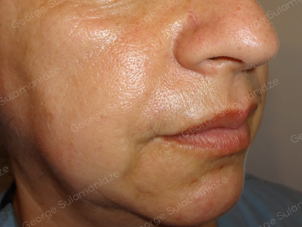
Results of the procedures
Before
After

Slide 18
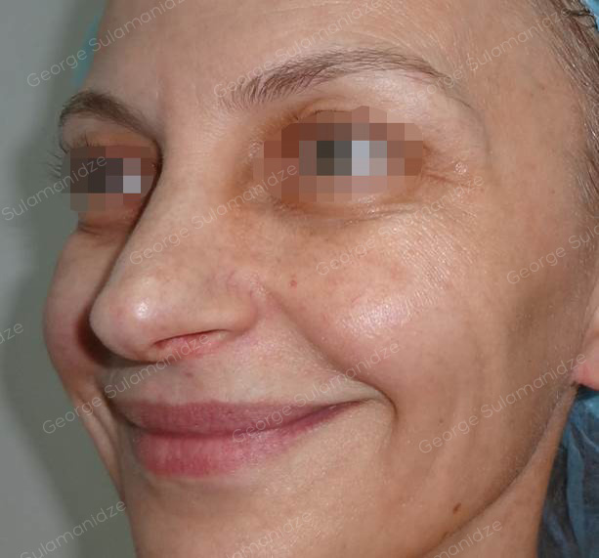
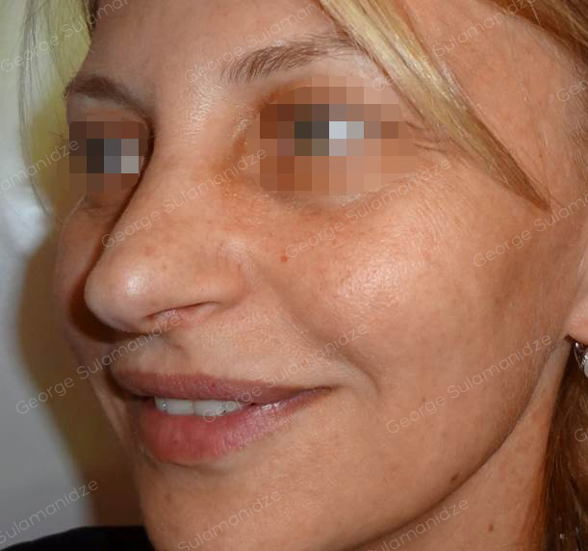
Results of the procedures
Before
After 7 months

